Slide 1

Story telling using data
By: Xavier Mokhtar

Slide 2
Scenario: EMPLOYEE/STUDENT TRAVELs to work
The target number of audience: 10-20 people
Topic: Travel time experience

Slide 3
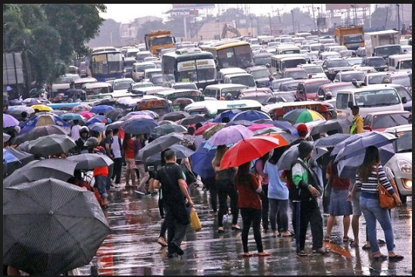
The majority of Filipino workers in Metro Manila endure daily traffic congestion that increases commute times and stress levels.

Slide 4
Employee Location
Most employees are located in Metro Manila
Mostly are in Mandaluyong

Slide 5
Mode of Transportation
Most employees prefers Jeepney as their medium
Tricycle are second to the most preferred mode.

Slide 6
Travel time
Student takes a long-time of 102.50 minutes to travel his/her work or school
Overall, it takes an average of 58.49 minutes to get to work.

Slide 7
Percentage of Time
Student spent 7.12%
With average of 4.06% time in a day

Slide 8
Travel Problems Encountered
Traffic congestion are most encountered.

Slide 9
How stressed are they?
Female employees who prefers shorter commute are moderately stressed.
While male employees who prefers longer commute are slightly stressed.

Slide 10
There might be a correlation between age and specific commute concerns. Younger individuals might prioritize convenience and shorter commutes, while older individuals might value health benefits and cost savings in their commute choices.

Slide 11
Individuals who identify as "Extremely stressed" seem to prefer shorter commutes, potentially indicating their urgency to minimize commute time to alleviate stress. On the other hand, those who are "Moderately stressed" or "Slightly stressed" show varying preferences between shorter and longer commutes, suggesting that their stress levels might not be strongly tied to commute duration.

Slide 12
Individuals who experience longer commute durations might be more likely to report higher stress levels. This could be due to the additional time spent in transit, potentially leading to frustration and tiredness. Conversely, those with shorter commutes might feel less stressed, benefiting from reduced travel time.

Slide 13
THANK YOU!

